Slide 1
The Impact of Soda Tax at Different Socioeconomic Levels on Health and Food Access and Insecurity
Evan Mucciolo, Natalia Mitchell, Albin Pierz, & Fizza Ali

Slide 2

Our Data
U.S. Department of Agriculture Food Environment Atlas
Assembles stats in 3 broad categories:
Food Choices
Health and Wellbeing
Community Characteristics
We focused on food choice and health and wellbeing

Slide 3
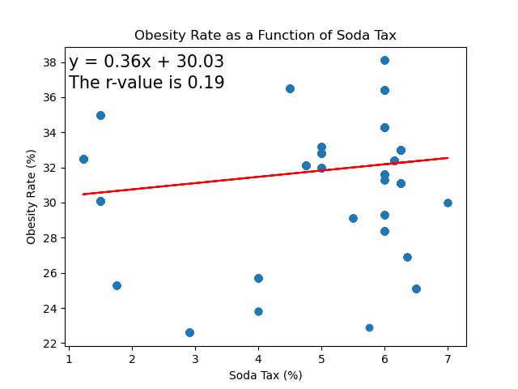
Does a Soda Tax Influence a Population's Obesity Rate?
No!
Plot of Soda Tax & Obesity Rate
Each datapoint represents a US State along with their average obesity rate
R-value = 0.19 indicating no correlation

Slide 4
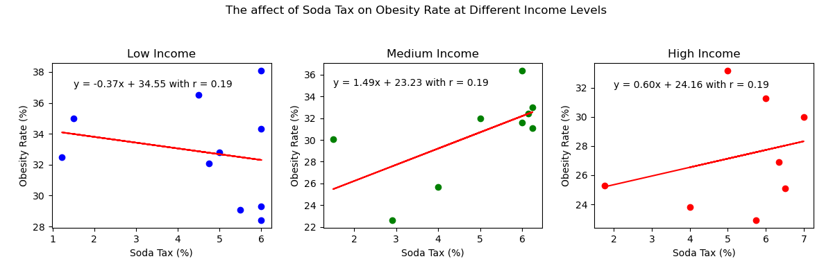
What about at different income levels?
Still no!
R-Value = 0.19 for all… indicating no correlation between soda tax and obesity
Binning was used to group data into low, medium, and high income groups
Tried to group the data so that roughly a third in each group

Slide 5
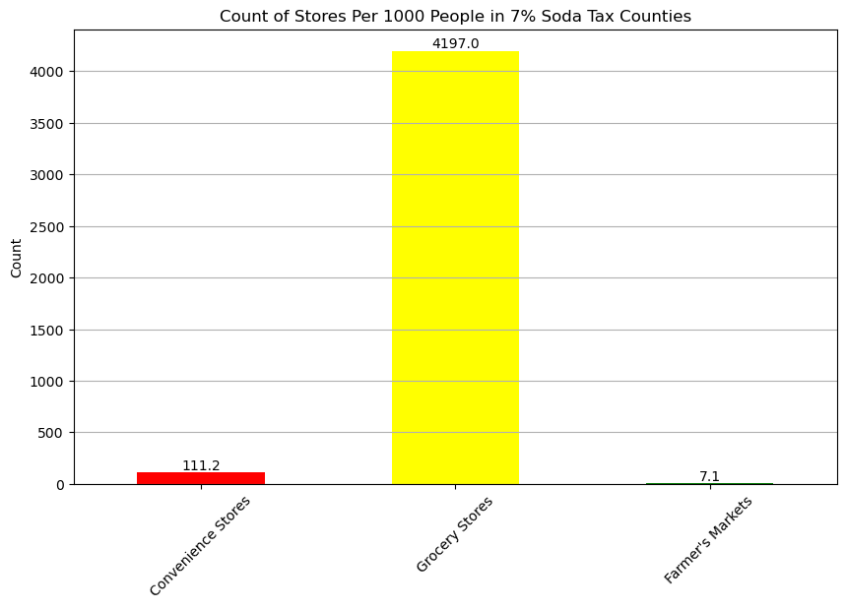
Do states with high soda taxes have access to fresh food?
The highest soda taxes in the nation are at 7%.
Here we see the total number of convenience stores (low access to fresh food), grocery stores, and farmers markets in the counties with 7% soda tax, per 1000 people.

Slide 6
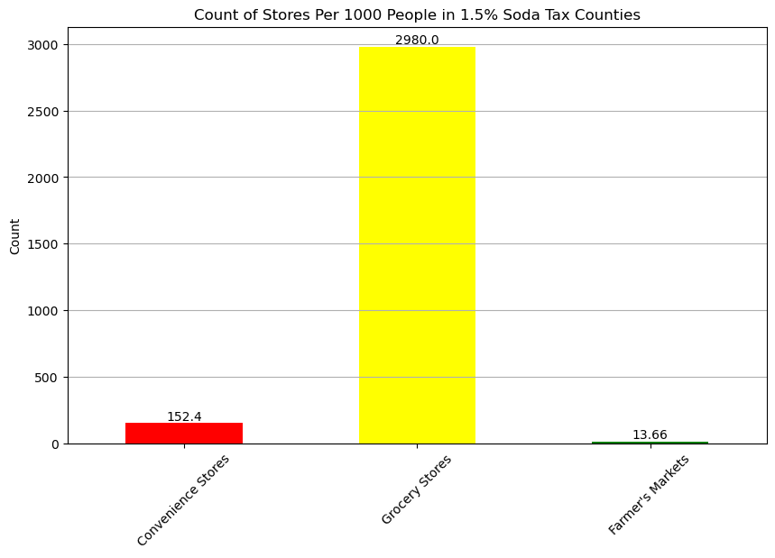
Do states with high soda taxes have access to fresh food?
The lowest soda tax rate (other than 0%) in the nation 1.5%.
In this graph, we can see that there are actually a lower amount of grocery stores per 1000 people, and slightly more convenience stores than in the highest tax bracket of 7%.
This signifies that high or low soda taxes probably do not impact access to fresh food in a negative way.

Slide 7
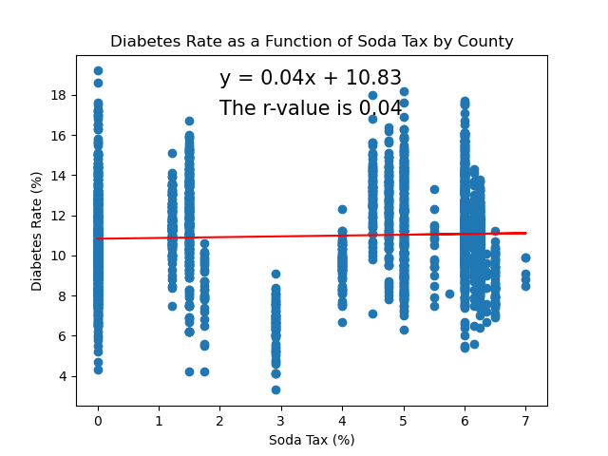
Does a Soda Tax Influence a Population's Diabetes Rate?
Initial hypothesis was higher tax would
have an impact on lowering diabetes rates
No impact on Diabetes rate
As indicated by r-value of 0.04
Junk Food Tax and Diabetes Rate Plot
Data points consist of every county in US
Parallels to Obesity Rate are evident.

Slide 8
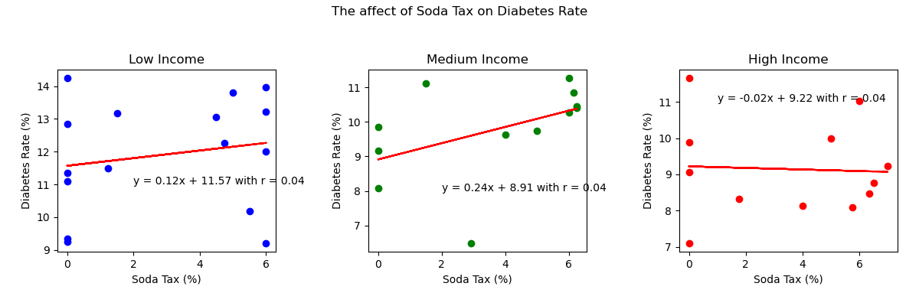
Does a Soda Tax Influence a Population's Diabetes Rate at Different Income Levels?
Still no influence as shown by the R-Value of 0.04
Equal division between three subcategories for continuity with other plots.

Slide 9
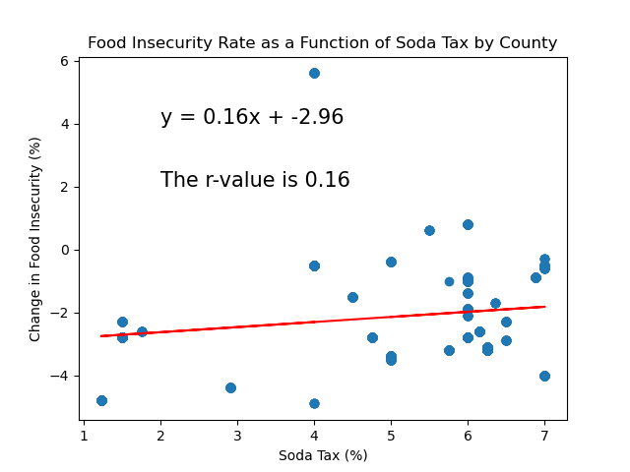
How Do Soda Taxes Influence Food Insecurity by Counties?
Weak Correlation: The low r-value (0.16) indicates a lack of correlation between the variables.
Minimal Soda Tax Impact: Despite the addition of a soda tax, the correlation remains barely noticeable.
Insignificant Impact on Food Insecurity: The soda tax did not significantly affect food insecurity levels.

Slide 10
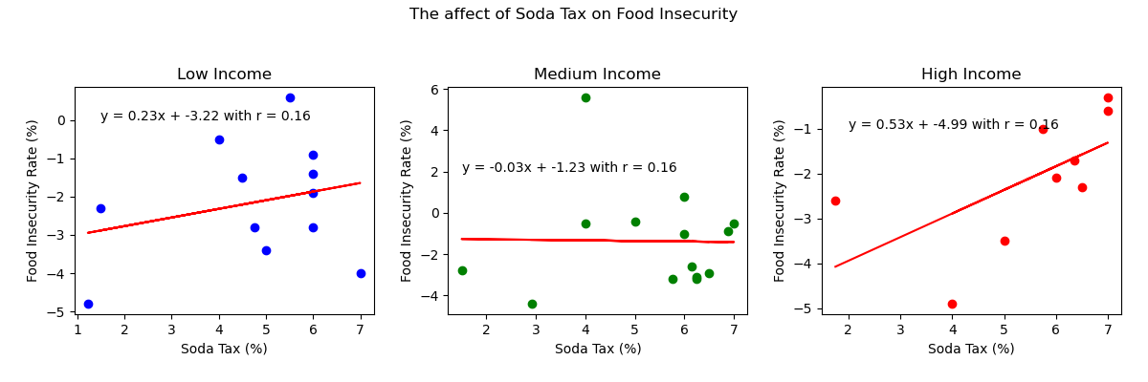
How Do Soda Taxes Influence Food Insecurity at Different Income Levels? (2)
Weak Correlation: The low r-value (0.16) suggests a weak correlation between variables.
Income Variation Impact: Despite income variations, soda taxes have minimal impact on fluctuations in food insecurity.
Limited Influence Across Incomes: The overall correlation stays low, highlighting the limited impact of soda taxes on food insecurity, regardless of income differences.

Slide 11
Analysis & Conclusion
Overall Correlation:
No correlation (r < 0.20) for all analysis.
Income Level Analysis:
Correlation remains consistent at r < 0.20 across different income levels.
Suggests that income levels do not significantly influence the relationship between soda tax and any of the other variables researched.
There is data that shows higher taxed areas have more access to fresh food and could be impacted less by this tax.

Slide 12
Our Data Sets & Repository
Economic Research Service (ERS), U.S. Department of Agriculture (USDA). Food Environment Atlas. https://www.ers.usda.gov/data-products/food-environment-atlas/
https://news.cornell.edu/stories/2021/05/study-grocery-taxes-increase-likelihood-food-insecurity
https://github.com/Evan-Mucciolo/Project-1-Junk-Food-Tax

